Slide 1

Using the Explainable AI SS3 Classification Model
Muneeb Vaiyani, Florian Angermeir
Technical University Munich
Department of Informatics
Munich, 06. July 2020

Slide 2
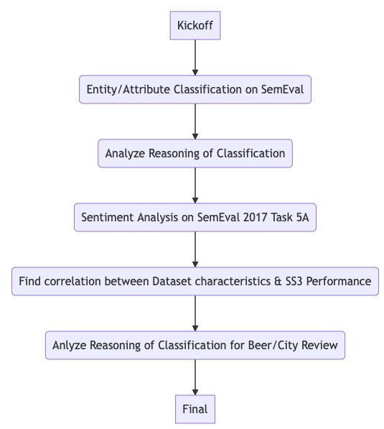
What happened so far?
Analyze Reasoning of Classification for Beer/City Review
Class specific hyperparameters

Slide 3
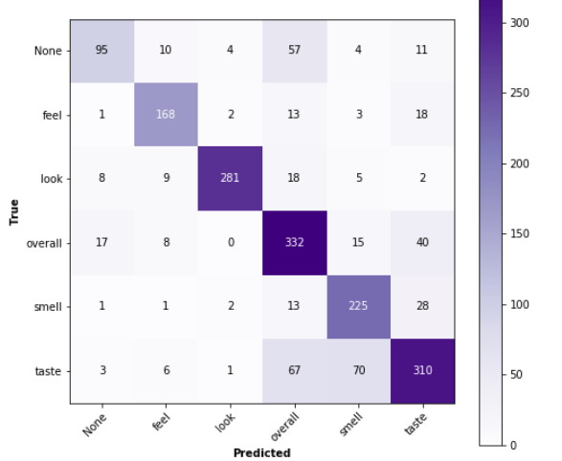
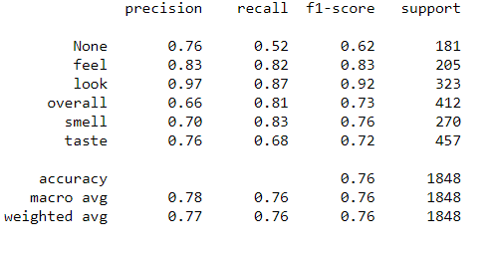
Analyze Reasoning of Beer Review

Slide 4
Analyze Reasoning of Beer Review

Slide 5
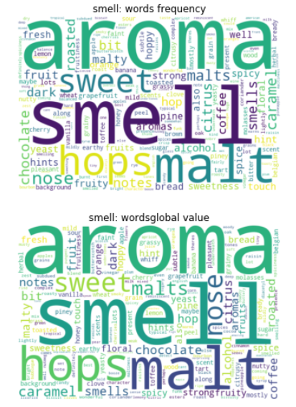
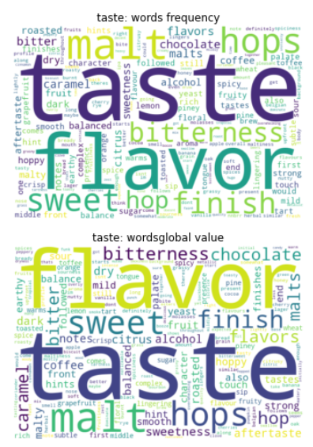
Analyze Reasoning of Beer Review
Occurrence in dataset
Importance to classifier

Slide 6
Analyze Reasoning of Beer Review
Misclassified samples (True positive would be Smell, but classified as Taste):
Sulphur character comes doubt heavy fermentation lager yeast blends rather smoothly pleasantly smoke dark characters give complete picture.
Biscuity rye adds spiciness.
Tiny bit bitterness earthy flare lying underneath majority one hands rich brewed coffee.
Classic belgian yeast must refreshing wintergreen lends almost physical coolness also perceived clean lemon.
Terribly appealing.
Phenols red berries malt fudge sweetness
this -> word is known for Smell, but cv(word, Smell) < cv(word, Taste)
this -> word is not known for Smell

Slide 7
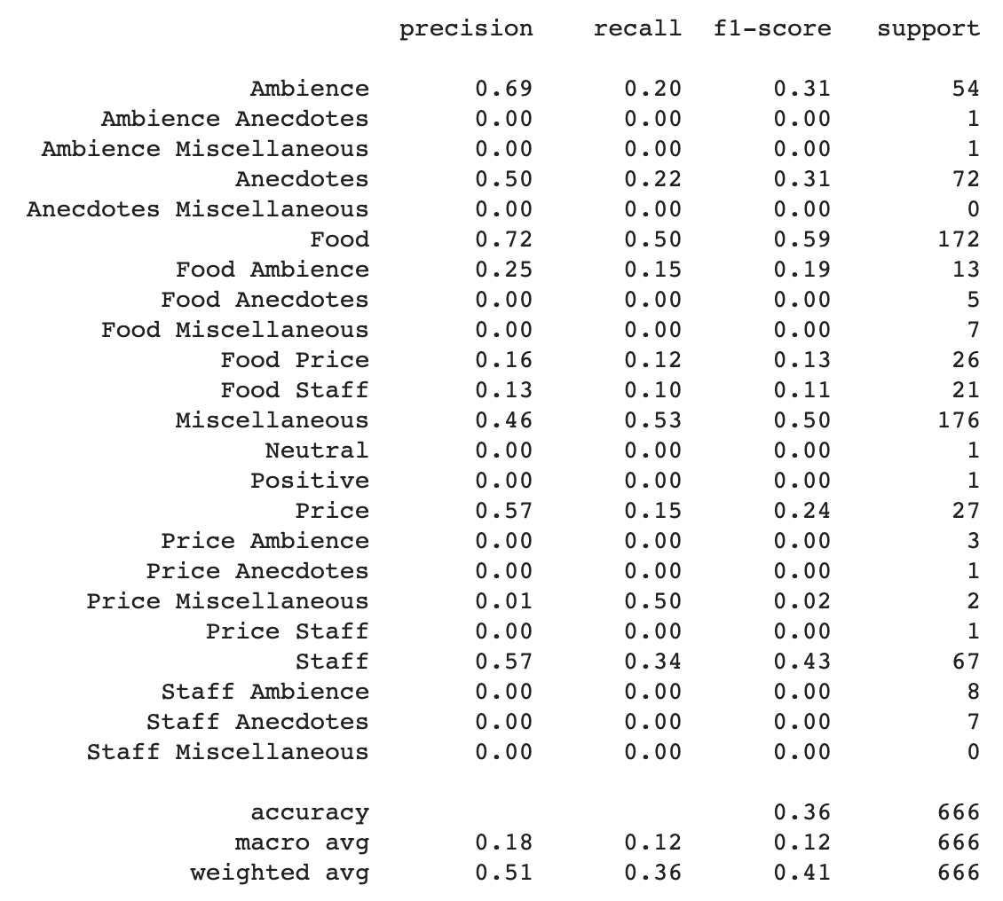
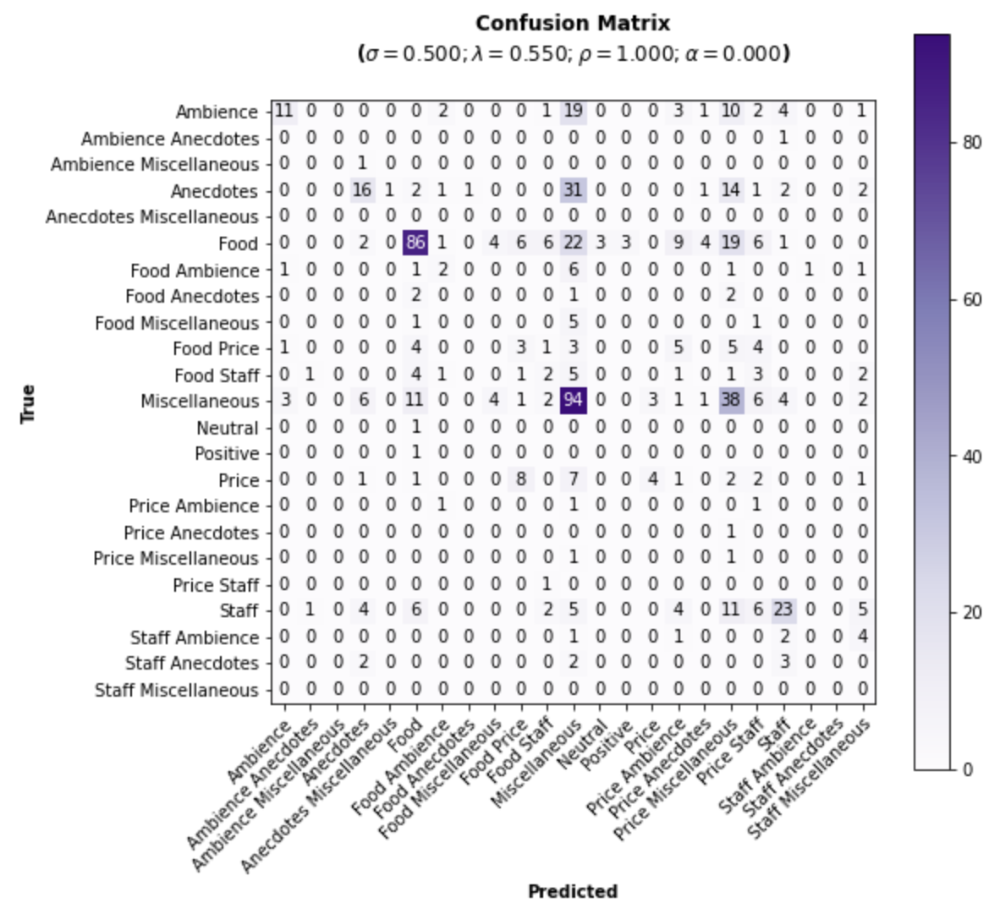
Analyze Reasoning of City Review

Slide 8
Analyze Reasoning of City Review

Slide 9
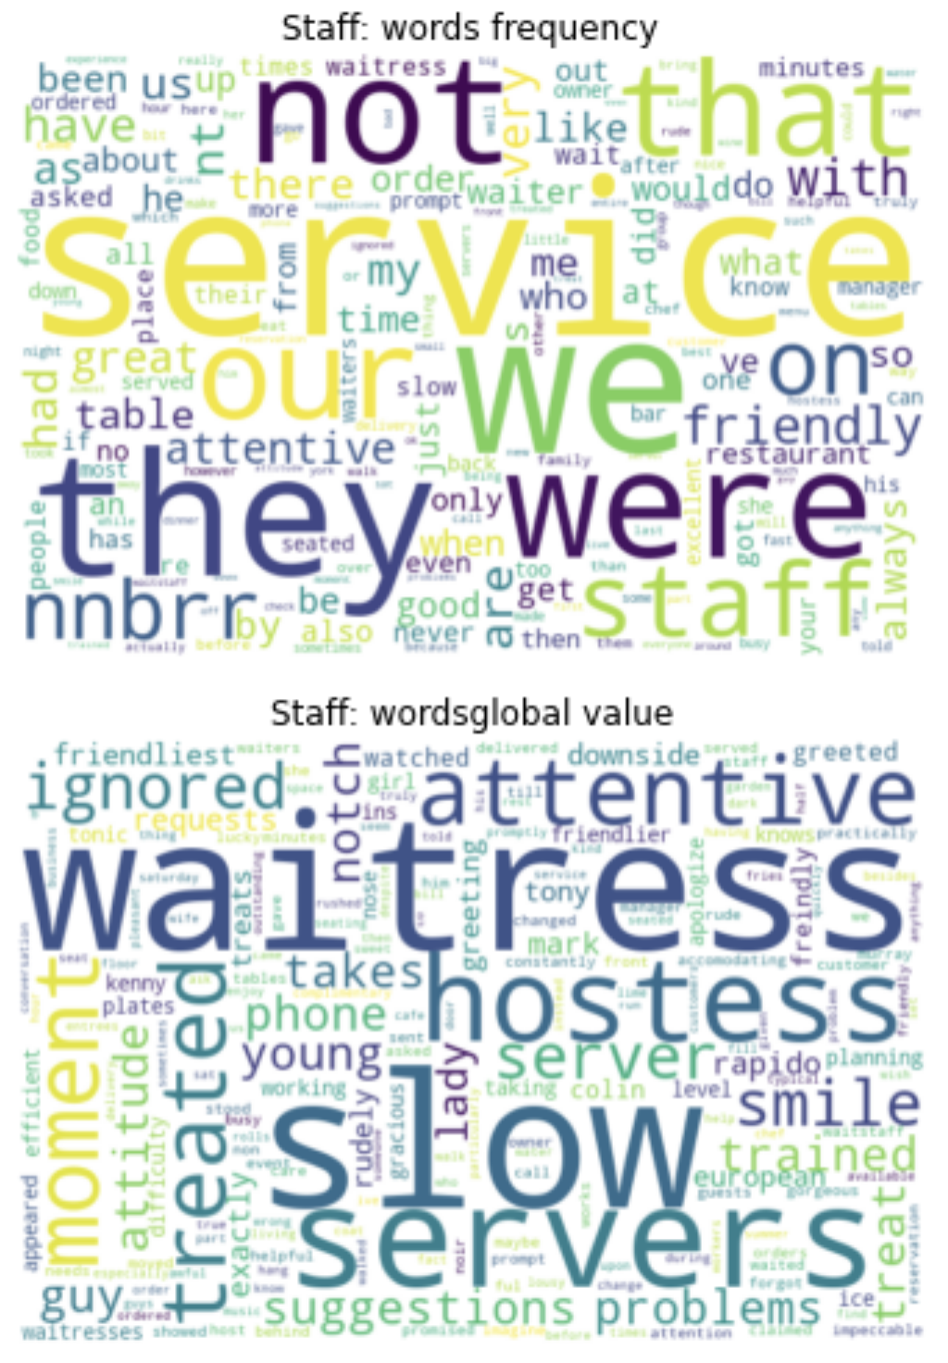
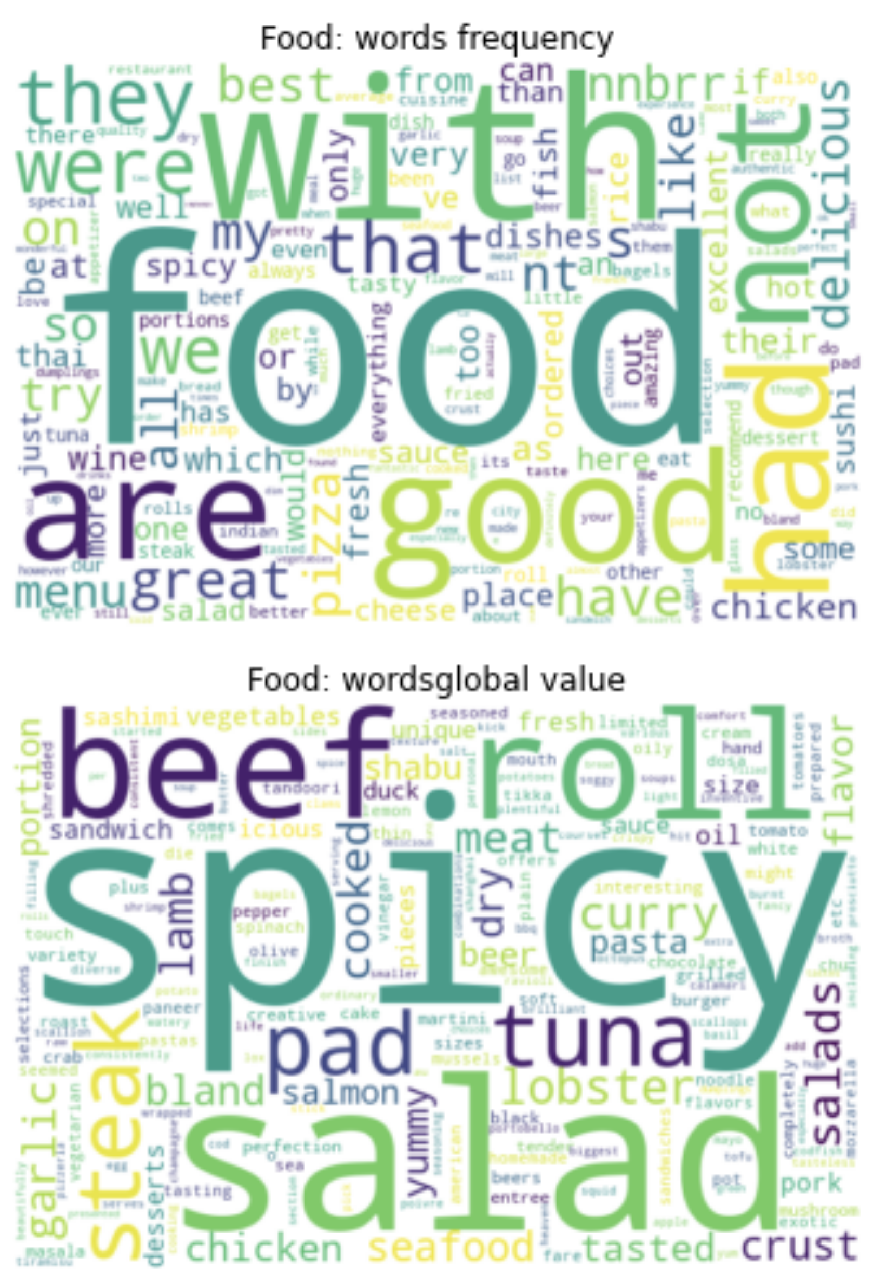
Analyze Reasoning of City Review
Occurrence in dataset
Importance to classifier

Slide 10
Analyze Reasoning of City Review
Misclassified samples (True positive would be Staff, but classified as Food):
“Only drawback - they wo n't toast your bagel , and they do n't make eggs for the bagel .” -> Inconsistent labeling
“in an effort to increase turnover , the restaurant offers no desserts beyond the complimentary espresso cup filled with chocolate mousse .”
“We only ordered desserts and drinks , but no refills were offered .”
“I liked the beer selection !”
“We both opted for a pasta dish and they were served timely and fresh .”
“The servers give you some sample slices of your order while you wait ( shortly I might add ) . ”
this means: word is not known for Staff, so cv=0
this means: word is known for Staff, but cv(word, Staff) < cv(word, Food)

Slide 11
Beer Review vs. City Review
Why is Beer Review performing so much better than City Review?
Fewer classes (Beer: 6 vs. City: 23)

Slide 12
Beer Review vs. City Review
Why is Beer Review performing so much better than City Review?
Lower overlap of important words between classes

Slide 13
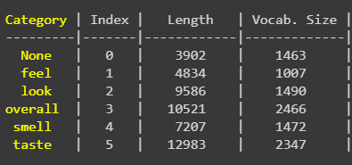
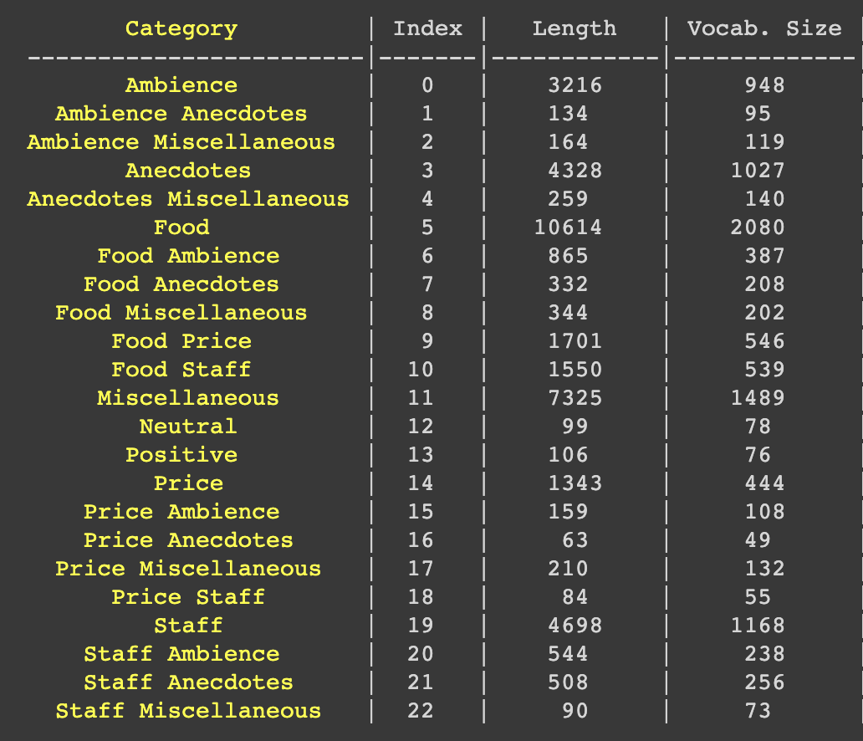
Beer Review vs. City Review
Why is Beer Review performing so much better than City Review?
More samples/bigger samples per class

Slide 14
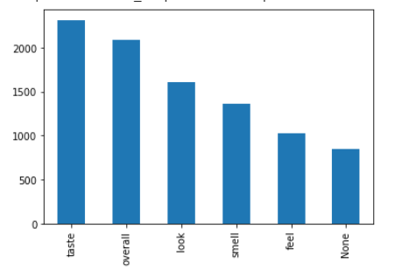
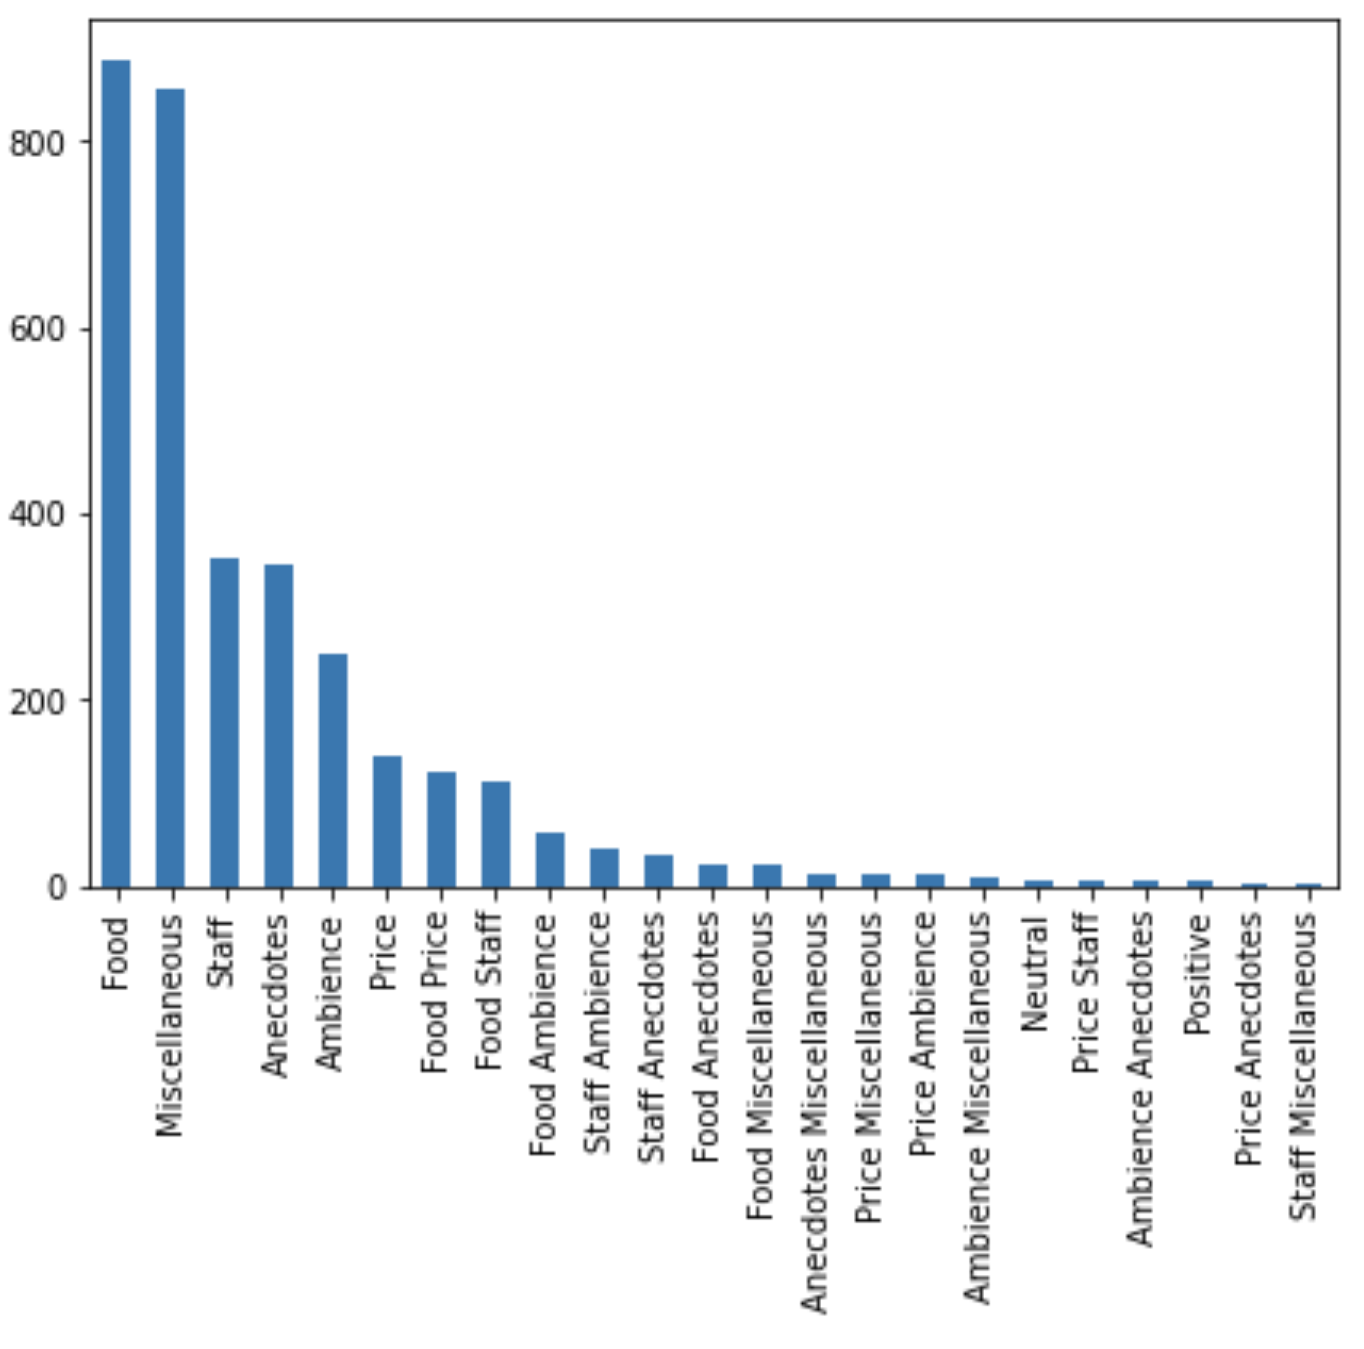
Beer Review vs. City Review
Why is Beer Review performing so much better than City Review?
Class Imbalance

Slide 15
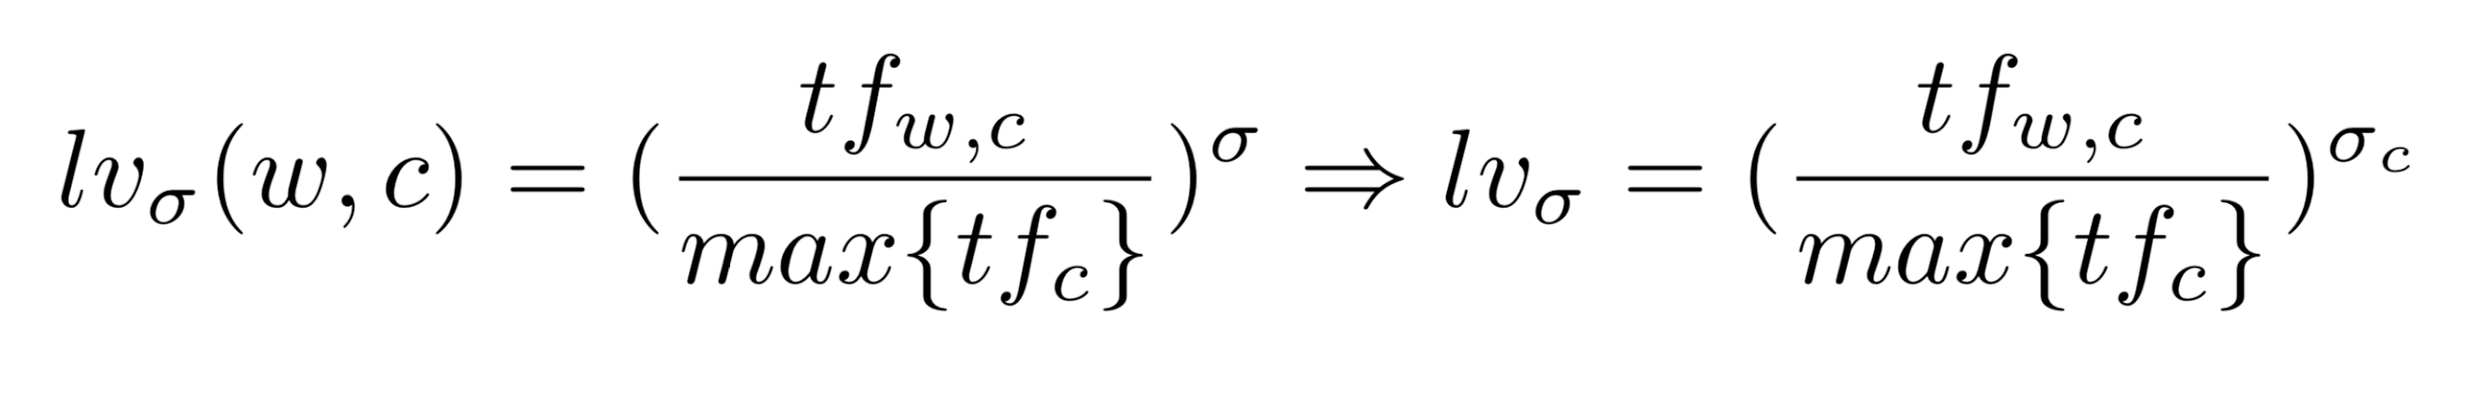
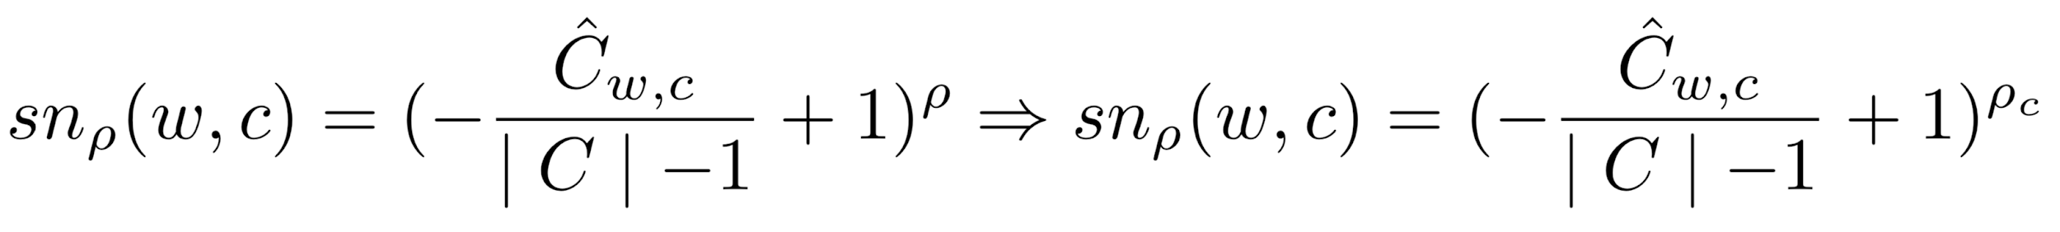
Class specific hyperparameters
Local Value:
Significance:
Sanction:

Slide 16
Class specific hyperparameters
Improvement
up to 5% (macro avg. f1 score) depending on the dataset
Complexity (Example)
3 Classes, 4 possible values per hyperparameter
Combinations for class unspecific hyperparameters: 4**3 = 64
Combinations for class specific hyperparameters: 4**3**3 = 4**9 = 262144
No specific hyperparameter with highest contribution to improvement
-> Complexity makes approach infeasible

Slide 17
Next Steps
Finalize documentation

Slide 18
Backup

